Slide 1
Image Generation with Guardrails

Slide 2
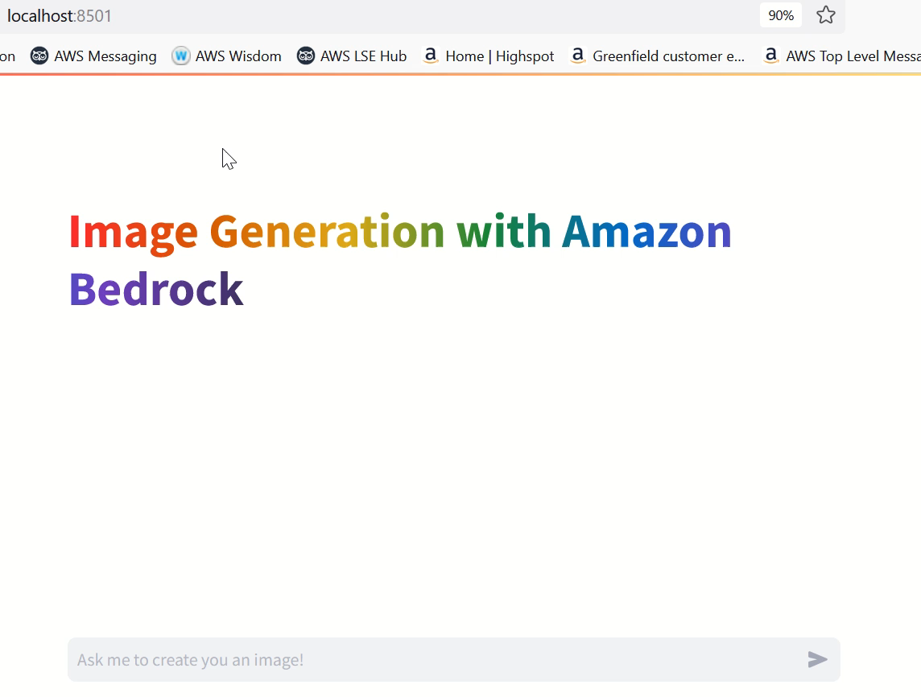
No Guardrails ☹

Slide 3
What?
Leverage AI and visualize your creative thoughts in a safe environment.
Why?
Validate your ideas, experiment and enhance your creativity with compliance.

Slide 4
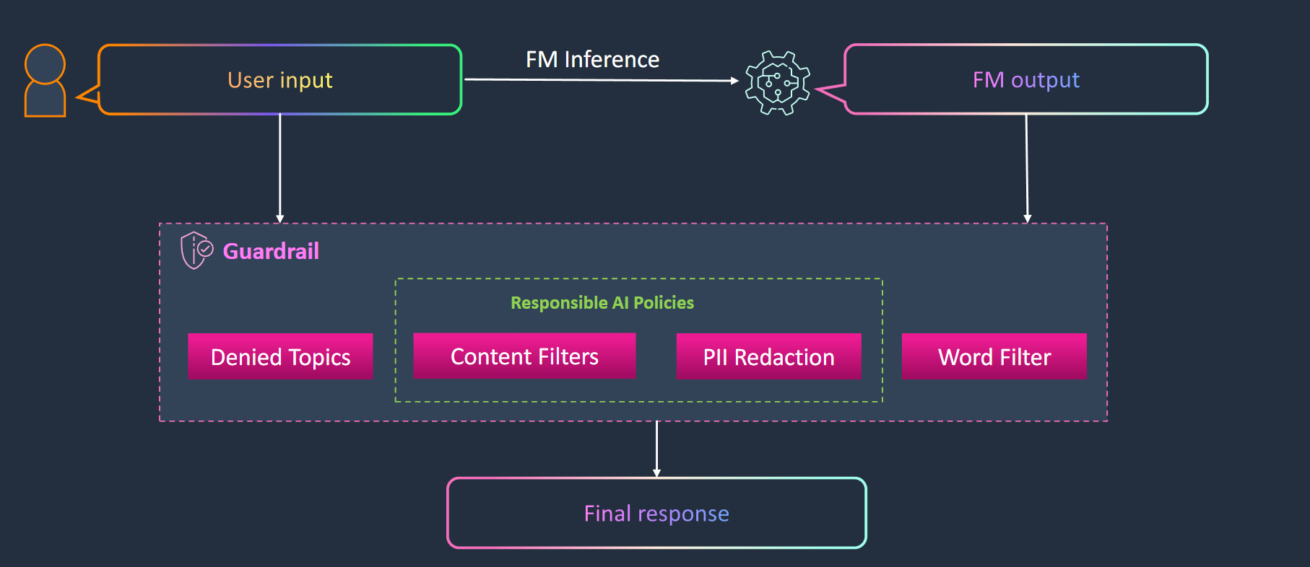
How?

Slide 5
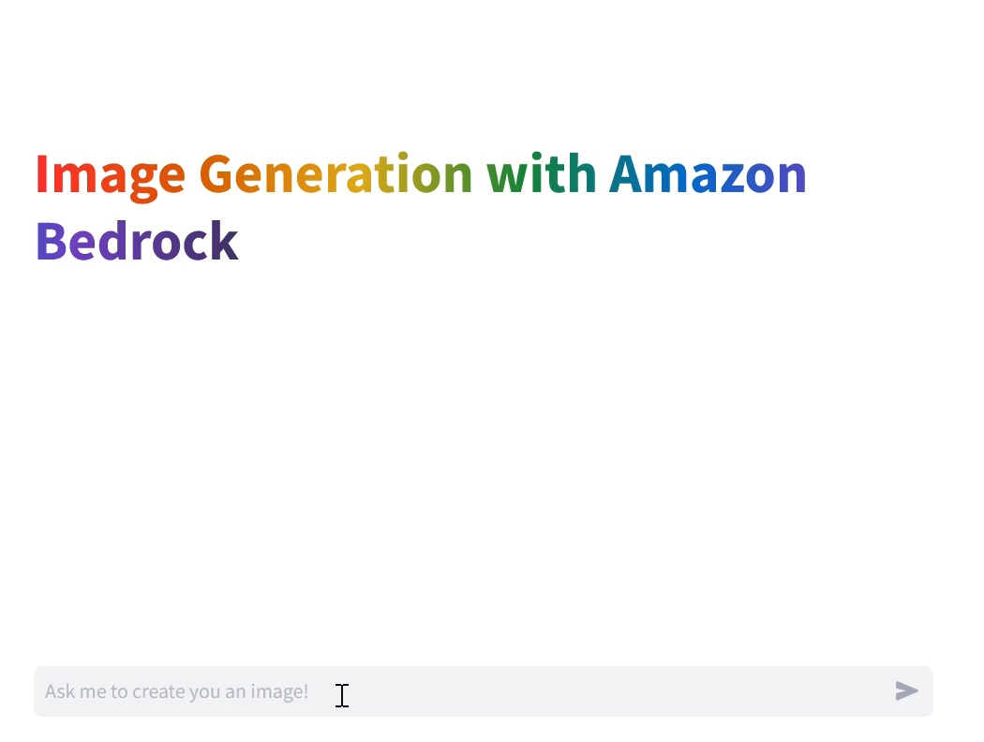
With Guardrails ☺

